Slide 1

KS3 Mathematics
N1 Powers of Ten
Notes:
The aim of this unit is to teach pupils to:
Understand and use decimal notation and place value; multiply and divide integers and decimals by powers of 10.
Compare and order decimals.
Round numbers, including to a given number of decimal places or significant figures.
Material in this unit is linked to the Key Stage 3 Framework supplement of examples pp 36-39.

Slide 2


Powers of ten
Our decimal number system is based on powers of ten.
We can write powers of ten using index notation.
10 = 10¹
100 = 10 × 10 = 10²
1000 = 10 × 10 × 10 = 10³
10 000 = 10 × 10 × 10 × 10 = 10⁴
100 000 = 10 × 10 × 10 × 10 × 10 = 10⁵
1 000 000 = 10 × 10 × 10 × 10 × 10 × 10 = 10⁶
10 000 000 = 10 × 10 × 10 × 10 × 10 × 10 × 10 = 10⁷ …
Notes:
Discuss the use of index notation to describe numbers like 10, 100 and 1000 as powers of 10. Be aware that pupils often confuse powers with multiples and reinforce the idea of a power as a number, in this case 10, repeatedly multiplied by itself.
Make sure that pupils know that 10³, for example, is said as “ten to the power of three”.
Explain that the index tells us how many 0s will follow the 1 (this is only true for positive integer powers of ten).
You may wish to mention that the standard meaning of a billion is 10⁹ (one thousand million). In the past, a British billion was one million million, or 10¹².
Links:
N4 Powers and roots – powers

Slide 3
Negative powers of ten
Any number raised to the power of 0 is 1, so
1 = 10⁰
We use negative powers of ten to give us decimals.
1
1
0.1 = = =10⁻¹
10
10¹
1
1
0.01 = = = 10⁻²
100
10²
1
1
0.001 = = = 10⁻³
1000
10³
1
1
0.0001 = = = 10⁻⁴
10000
10⁴
1
1
0.00001 = = = 10⁻⁵
100000
10⁵
1
1
0.000001 = = = 10⁻⁶
1000000
10⁶
Notes:
Discuss the convention of using negative integers to express tenths, hundredths, thousandths, and other negative powers of ten.
Link:
N4 Powers and roots – powers

Slide 4
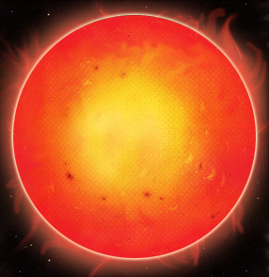
Standard form – writing large numbers
We can write very large numbers using standard form.
To write a number in standard form we write it as a number between 1 and 10 multiplied by a power of ten.
For example, the average distance from the earth to the sun is about 150 000 000 km.
We can write this number as 1.5 × 10⁸ km.
A number between 1 and 10
A power of ten
Notes:
Discuss the use of standard form to write large numbers.
Discuss whether 10×10⁵ and 1×10⁴ are correct examples of standard form. The first is not whereas the second is; if the discussion is interesting, you might want to discuss how to use inequality notation to show exactly what is meant by ‘between 1 and 10’ in the definition of standard form.

Slide 5
Standard form – writing large numbers
How can we write these numbers in standard form?
80 000 000 =
8 × 10⁷
230 000 000 =
2.3 × 10⁸
724 000 =
7.24 × 10⁵
6 003 000 000 =
6.003 × 10⁹
371.45 =
3.7145 × 10²
Notes:
Discuss how each number should be written in standard form.
Notice that the power of ten will always be one less than the number of digits in the number.

Slide 6
Standard form – writing large numbers
These numbers are written in standard form. How can they be written as ordinary numbers?
5 × 10¹⁰ =
50 000 000 000
7.1 × 10⁶ =
7 100 000
4.208 × 10¹¹ =
420 800 000 000
2.168 × 10⁷ =
21 680 000
6.7645 × 10³ =
6764.5
Notes:
Discuss how each number written in standard form should be written in full.

Slide 7
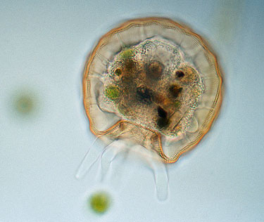
Standard form – writing small numbers
We can also write very small numbers using standard form.
To write a small number in standard form we write it as a number between 1 and 10 multiplied by a negative power of ten.
For example, the width of this shelled amoeba is 0.00013 m.
We can write this number as 1.3 × 10⁻⁴ m.
A number between 1 and 10
A negative power of 10
Notes:
The image of a shelled amoeba has been reproduced with the kind permission of Wim van Egmond © Microscopy UK http://www.microscopy-uk.org.uk/index.html

Slide 8
Standard form – writing small numbers
How can we write these numbers in standard form?
0.0006 =
6 × 10⁻⁴
0.00000072 =
7.2 × 10⁻⁷
0.0000502 =
5.02 × 10⁻⁵
0.0000000329 =
3.29 × 10⁻⁸
0.001008 =
1.008 × 10⁻³
Notes:
Notice that the power of ten is always ‘–’ and the number of zeros before the first significant figure including the one before the decimal point..

Slide 9
Standard form – writing small numbers
These numbers are written in standard form. How can they be written as ordinary numbers?
8 × 10⁻⁴ =
0.0008
2.6 × 10⁻⁶ =
0.0000026
9.108 × 10⁻⁸ =
0.00000009108
7.329 × 10⁻⁵ =
0.00007329
8.4542 × 10⁻² =
0.084542
Notes:
Notice that the power of ten tells us the number of zeros before the first significant figure including the one before the decimal point..

